Slide 1

Testbed for Validating Second-Generation TDI and Clock Noise Correction for LISA
Karin Kruuse, Reid Ferguson, Sourath Ghosh, Patrick Krieger, Daniele Vetrugno, Guido Mueller Max Planck Institute for Gravitational Physics/Leibniz University Hannover
Notes:
This is a status report

Slide 2
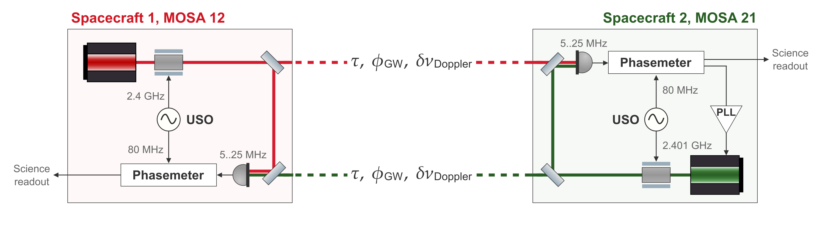

LISA Science Interferometer
Two primary noises in the LISA raw data – laser noise and clock timing jitter
Notes:
Stress that we want to replicate these noise couplings for the carrier or inter-spacecraft interferometer
Mention the reason for the testbed
Clarify the goal of the testbed more? Like our results are results for TDI. In best case scenario we just show that simultaions are fine

Slide 3
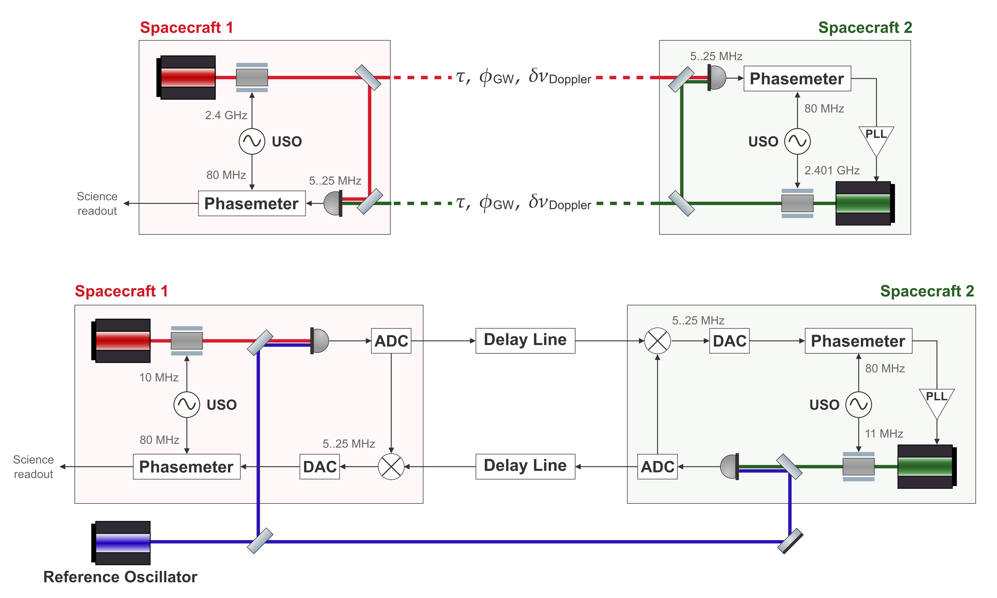
Replicating the LISA Arm in the Lab
LISA arm
Testbed arm

Slide 4
Replicating the LISA Arm in the Lab
LISA arm
Carrier from 281 THz to ~50MHz
Testbed arm

Slide 5
Replicating the LISA Arm in the Lab
LISA arm
Inter-satellite interferometers
Testbed arm
Notes:
Mention delayline was talked about! That’s our starting point. Transition from eletronic to opto electronic (add somewhere)

Slide 6
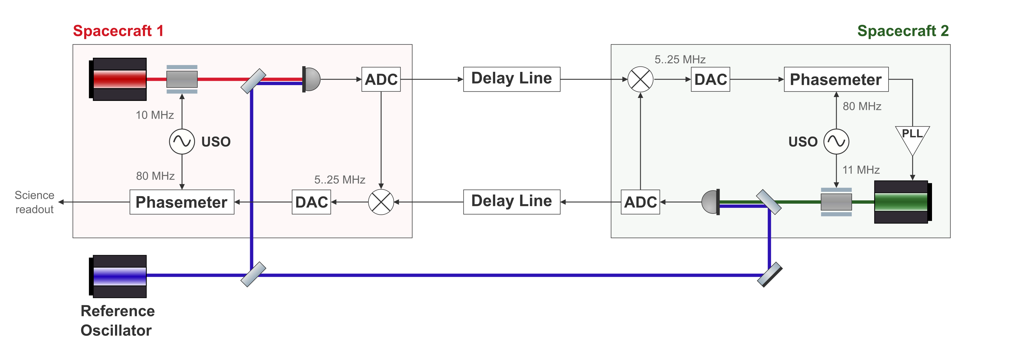
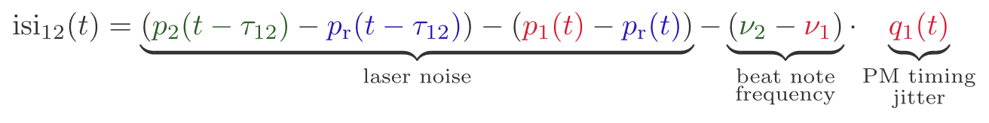
Replicating the LISA Arm in the Lab
LISA arm
Testbed arm
Notes:
Fix the signs

Slide 7
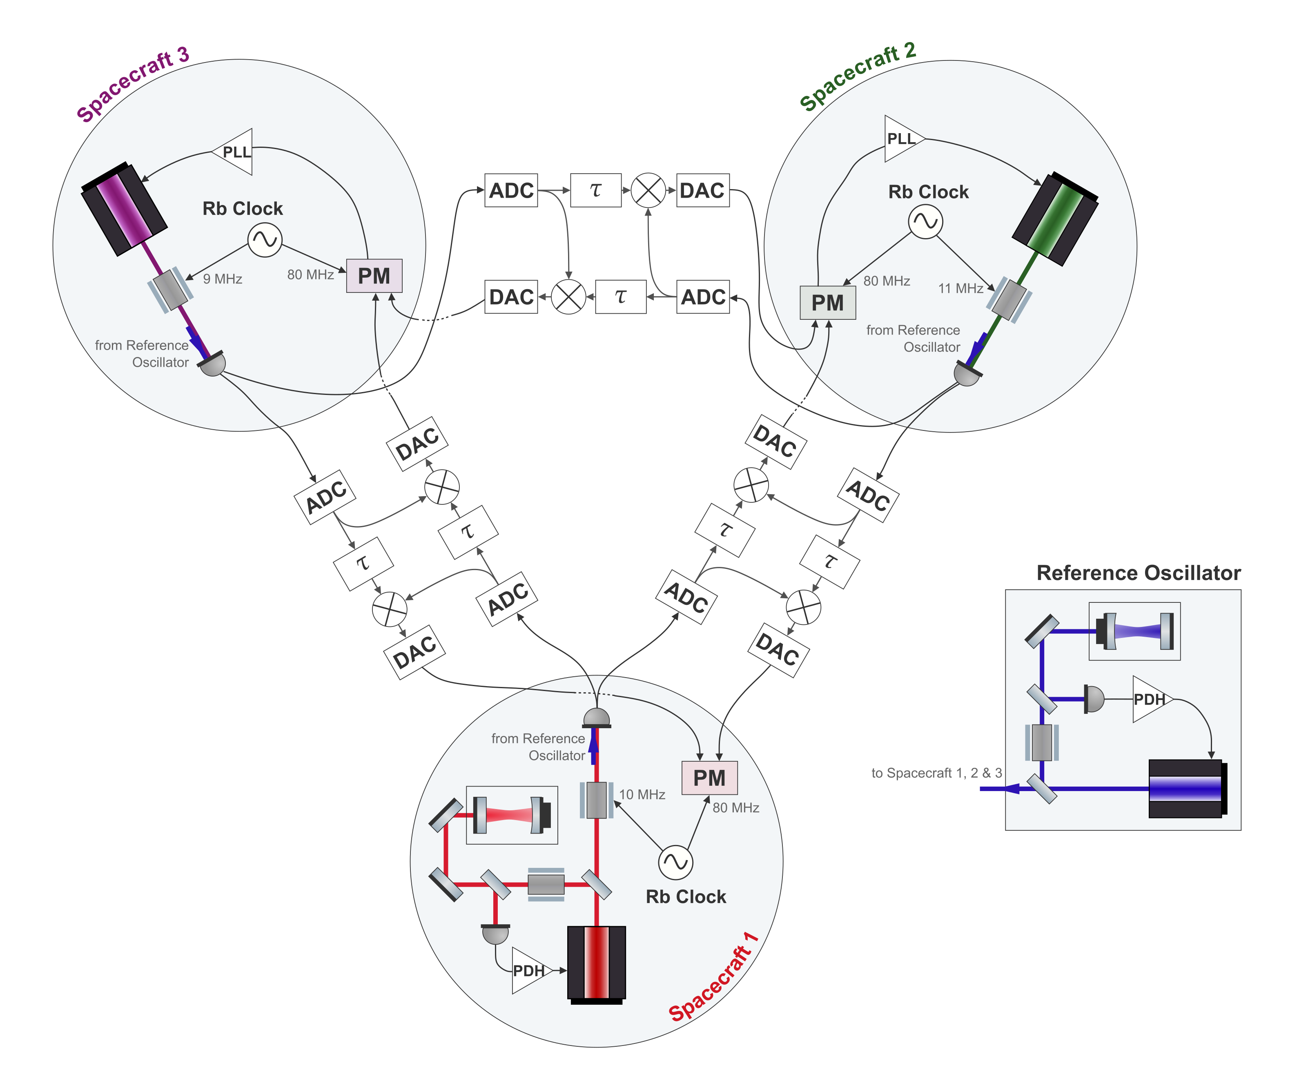
Full Testbed
One laser per spacecraft
Cavity locked primary laser
Independent clocks
Six separate delay lines
Notes:
Lasers, delaylines, locking, add pic of lab

Slide 8
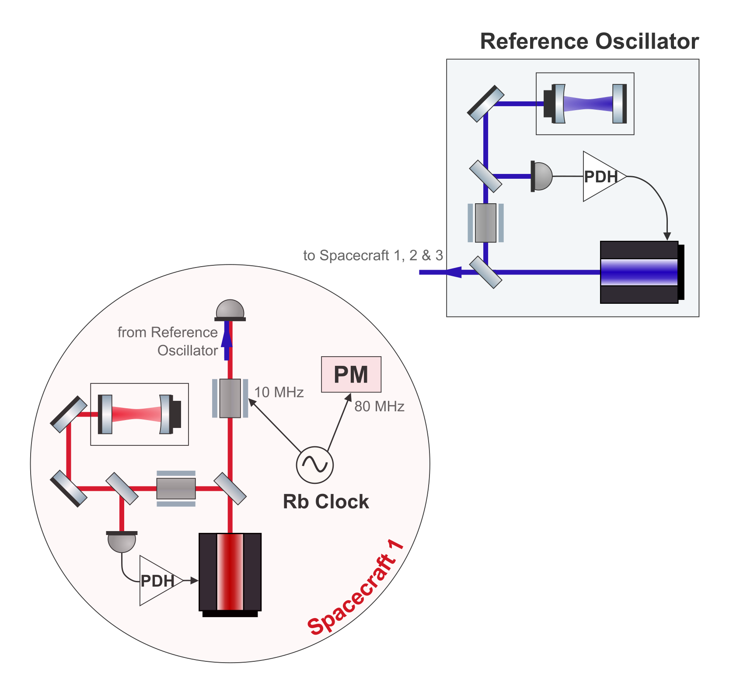
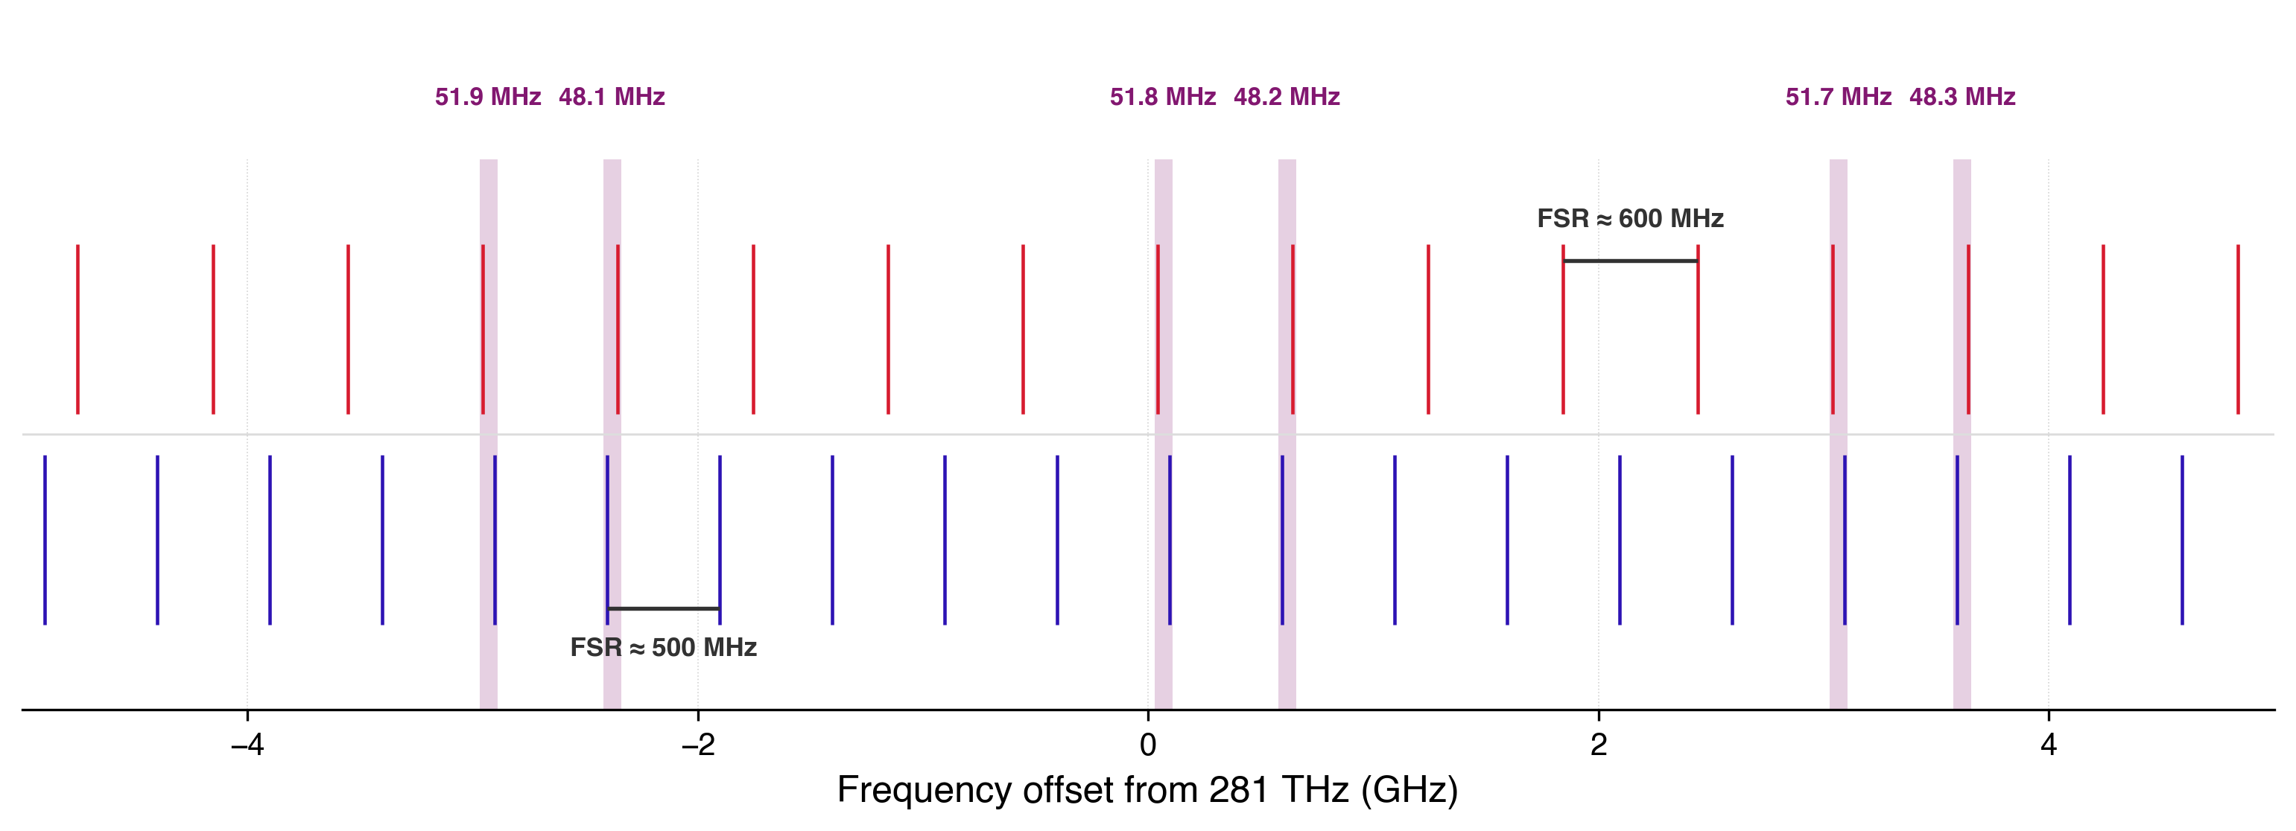
Cavity Locking Two Lasers
For LISA-like laser noise the primary laser should be cavity locked.
Two lasers locked to separate cavities – 25 cm and 30 cm
Two separate Pound-Drever-Hall (PDH) locks
Beat note needs to be below 60 MHz
Illustrative cavity resonances
Notes:
The length variability, like how it affects the

Slide 9
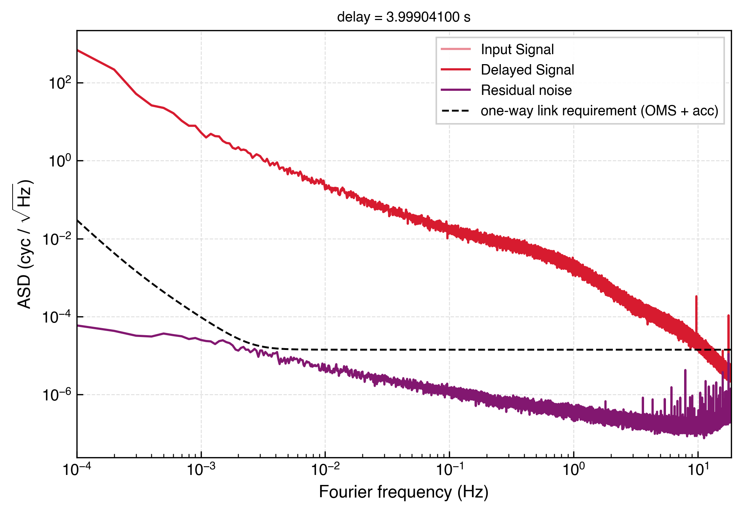
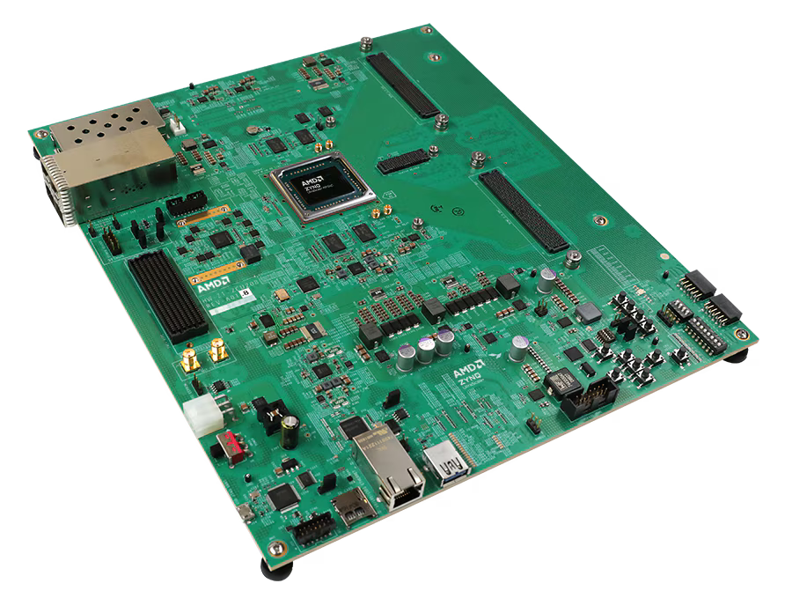
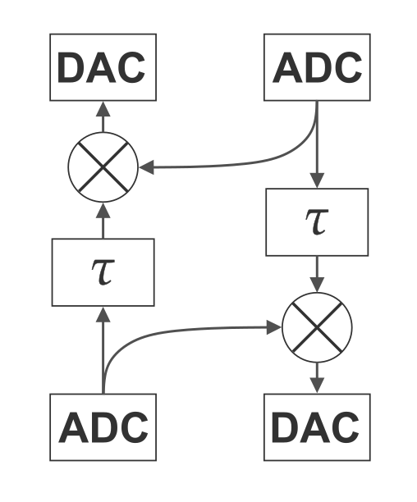
Delay Line
Time varying delays
Doppler shifts for both the carrier and sidebands
Gravitational wave injection
AMD Zynq™ UltraScale+™ RFSoC ZCU208 Evaluation Kit
Intrinsic noise floor of one board in purple
Notes:
Designed for softwawre RF

Slide 10
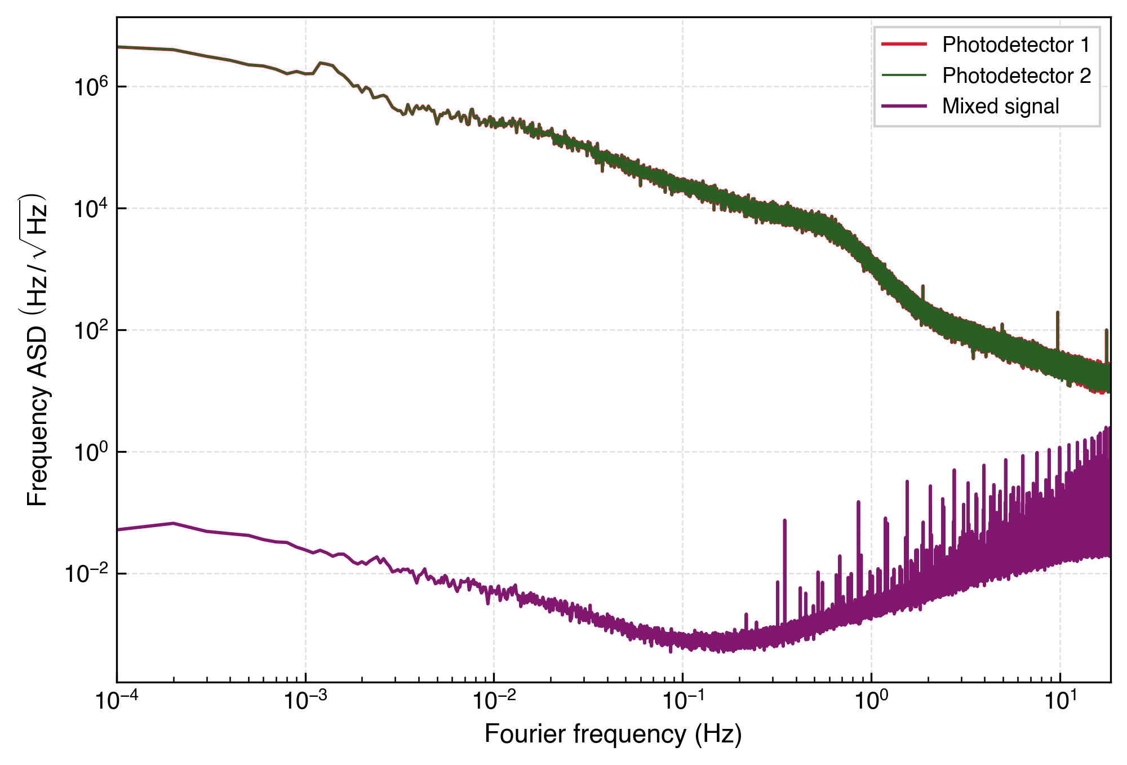

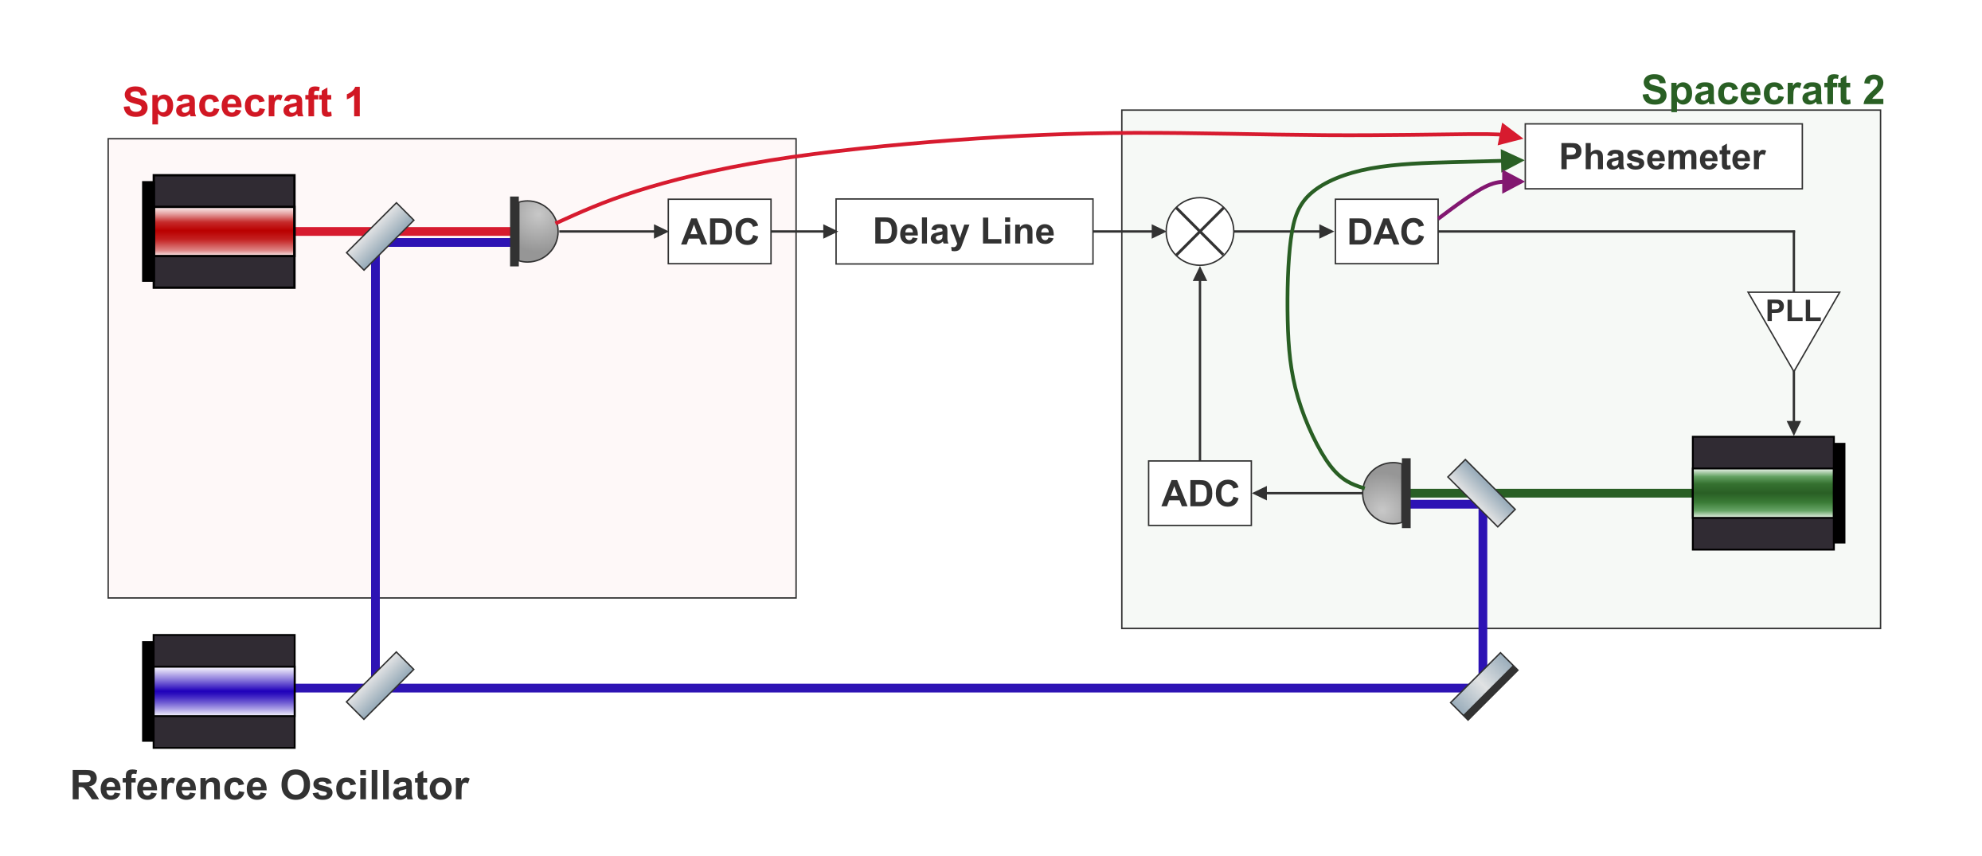

PLL Lock of Far Spacecraft
Photodetector readings are dominated by free running laser frequency noise.
Mixed output is orders of magnitude lower.

Slide 11
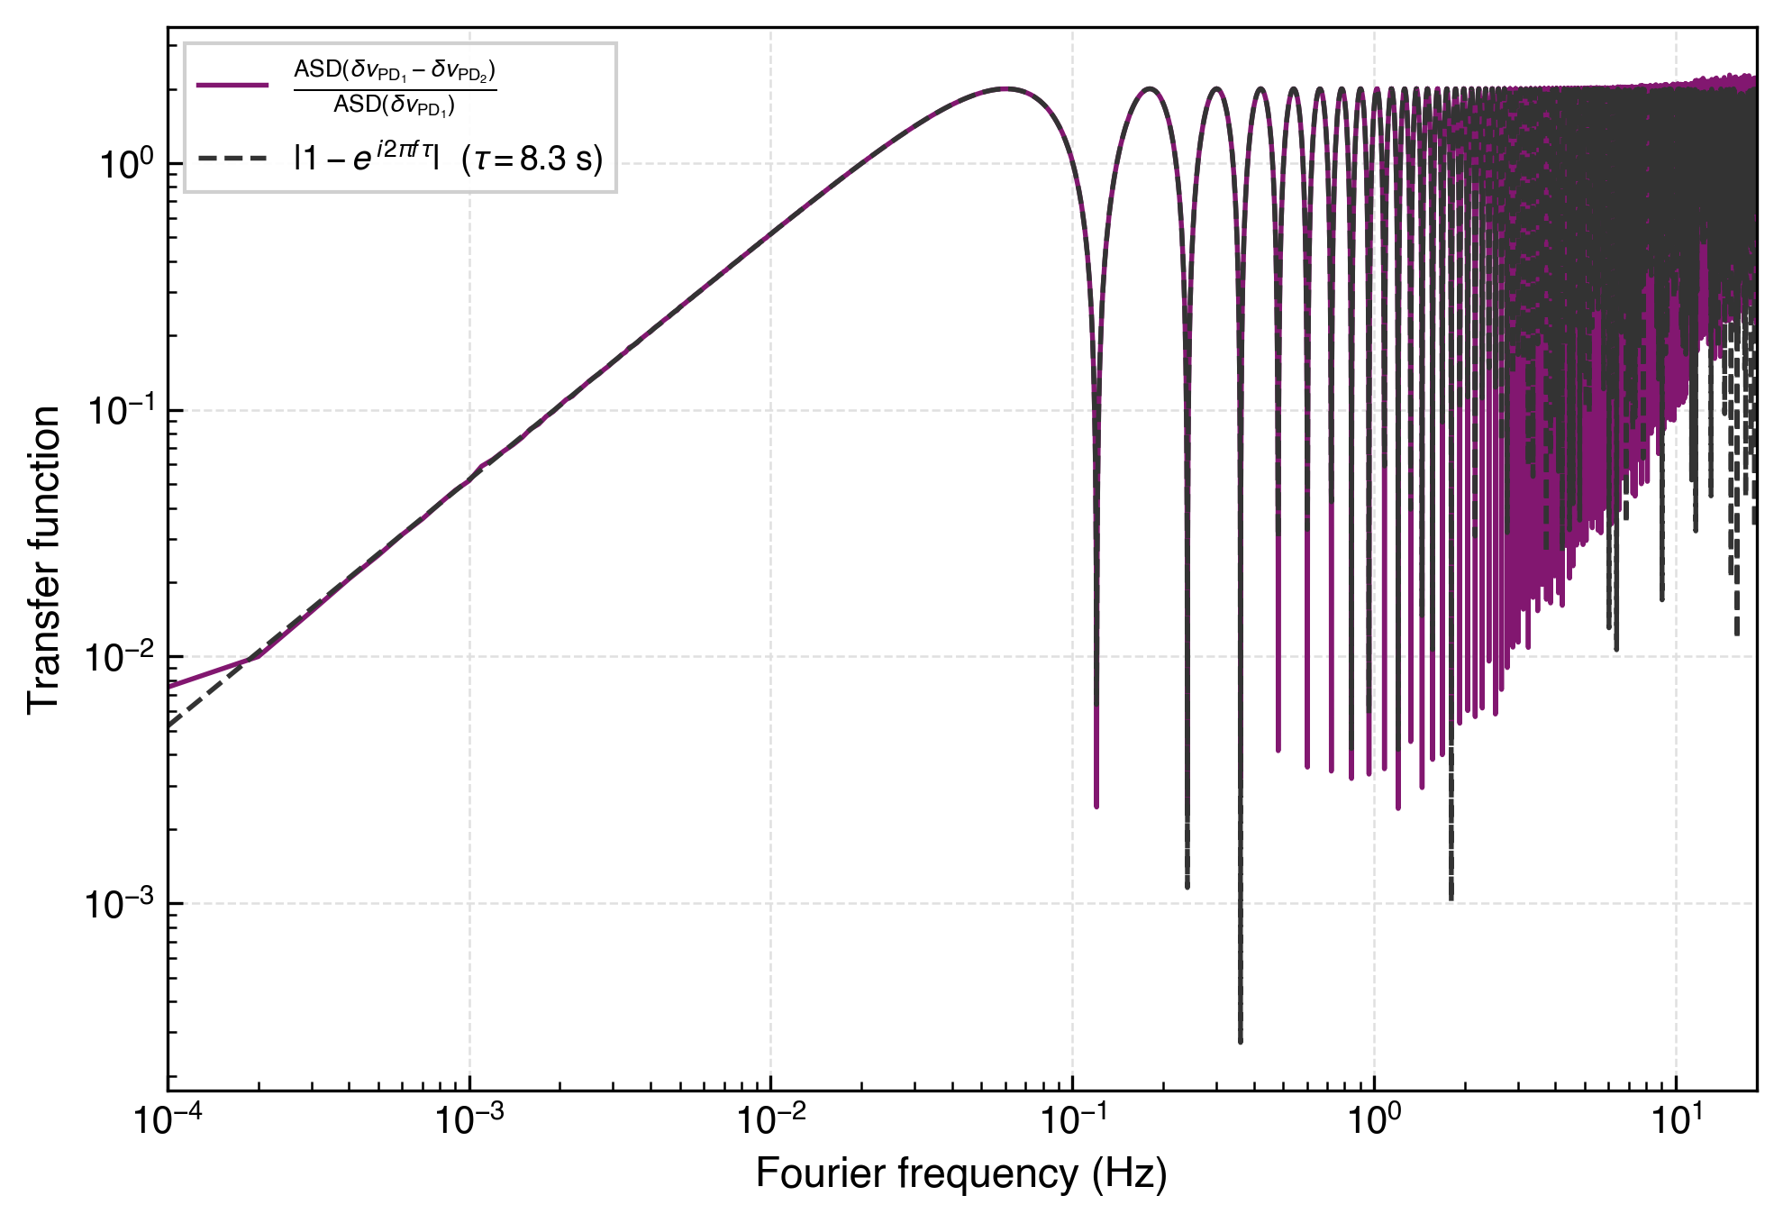
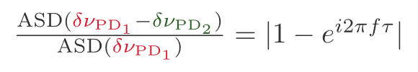
PLL Lock of Far Spacecraft
We can recover a LISA-like one-way laser noise transfer function
Notes:
Explain the extraction clearly

Slide 12
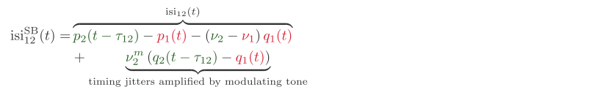
Clock Noise Transfer in LISA
Notes:
Clarify the modulating freq.
Add clarifing notes for the terms/frequencies (already in previous slides)

Slide 13
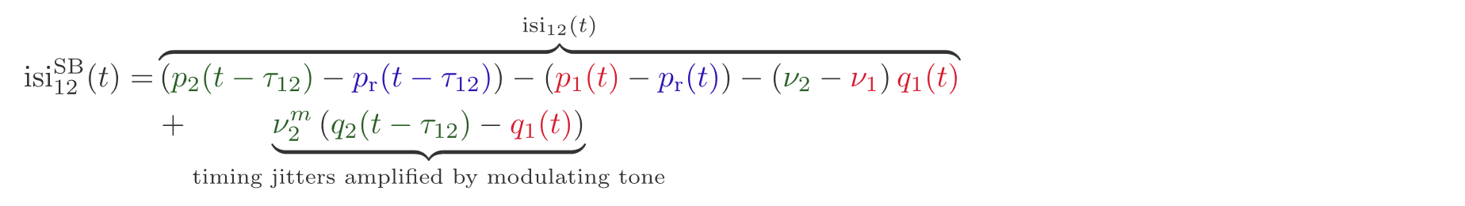
Sidebands in the Lab
LISA arm
Testbed arm
Notes:
Highlight the modulation frequency in the text, explain the GHz limitation better change slide text, this is sideband

Slide 14
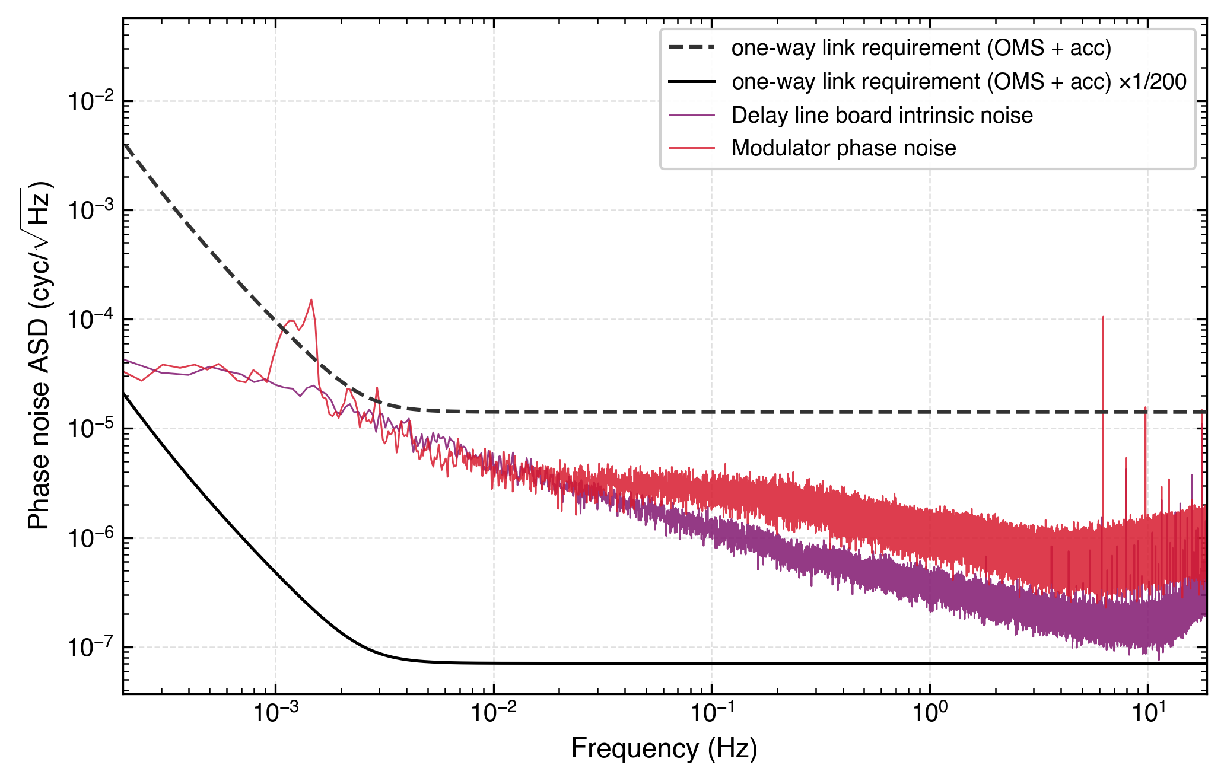
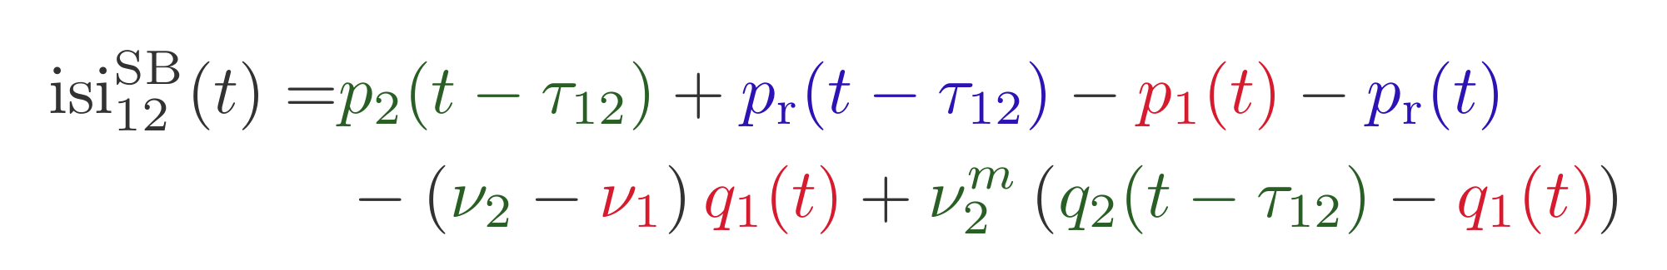
Clock Tone Transfer Performance
Modulator noise and the intrinsic noise of the delay line board remain too loud if MHz modulation is used.

Slide 15
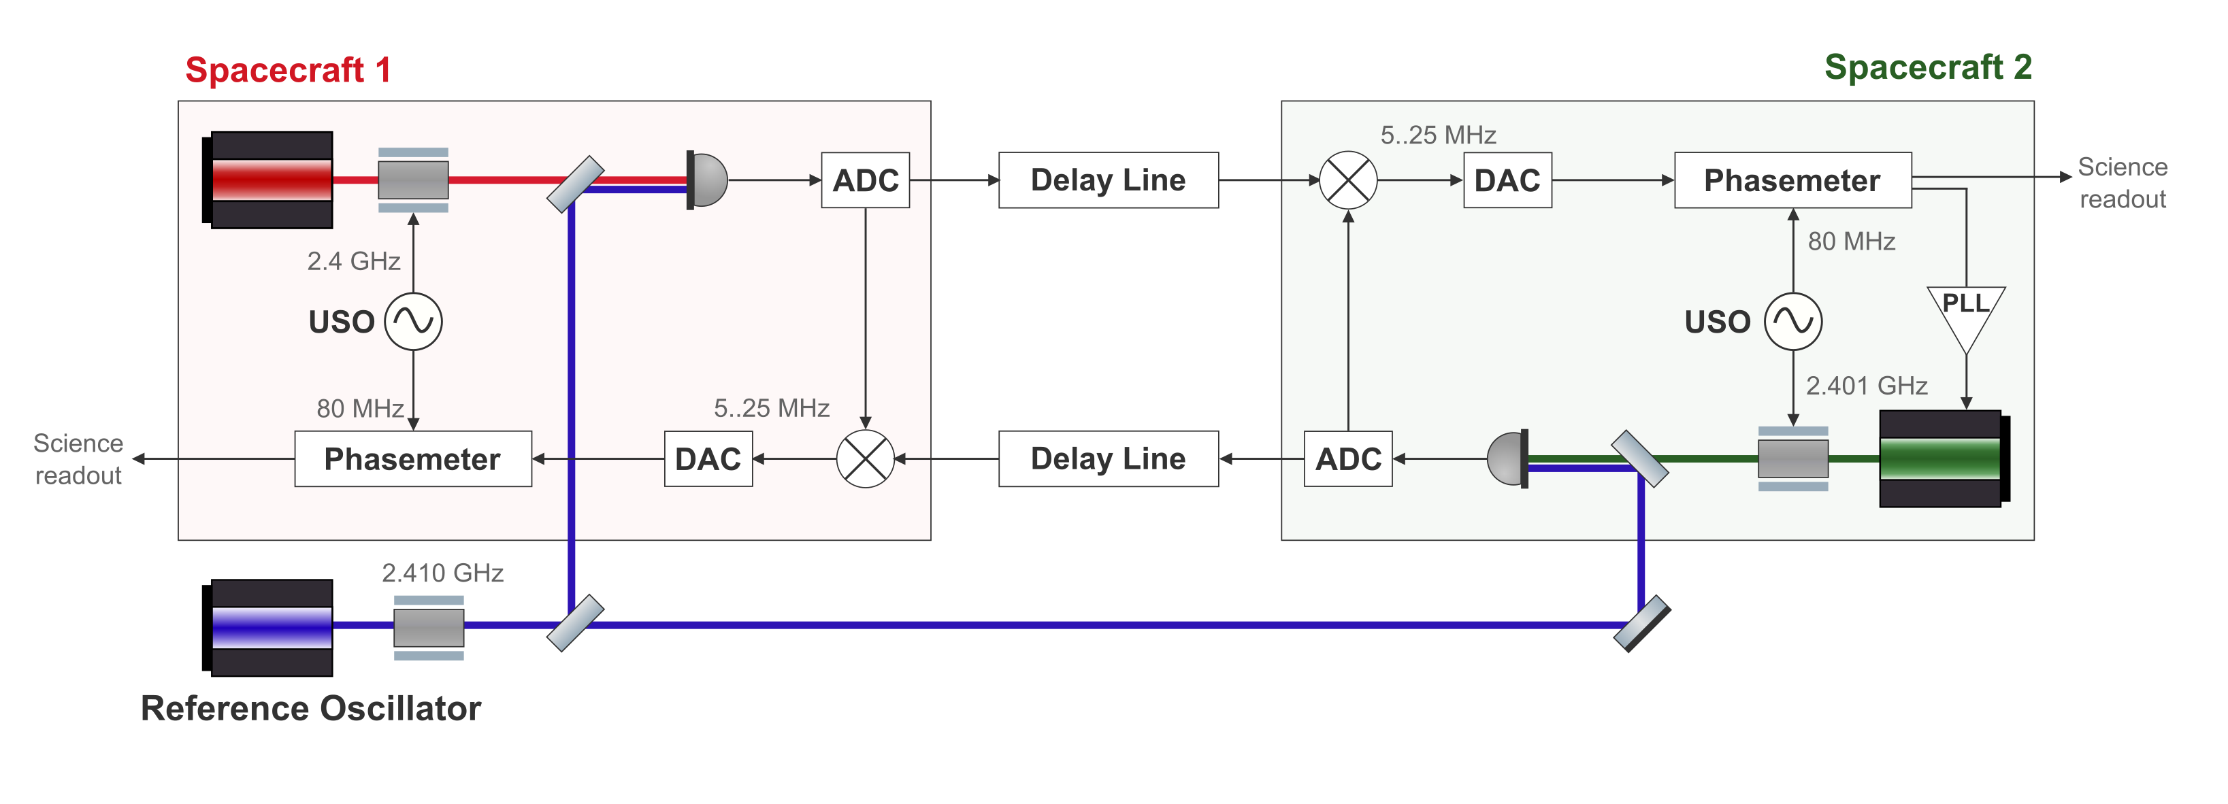
GHz Modulation – Option 1
Heterodyned sideband beat notes add a new timing jitter to the mix.
Where to derive the modulating tone from?
Notes:
Solution nr 1

Slide 16
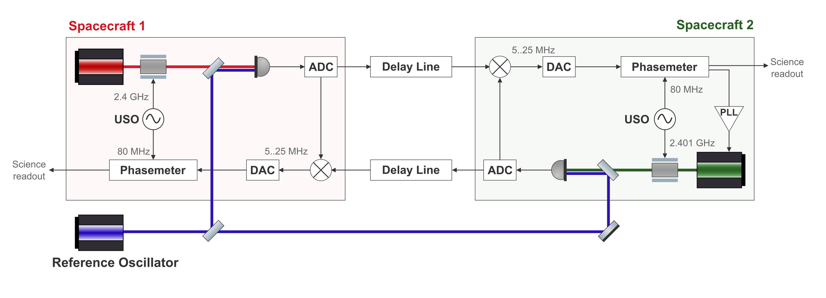
GHz Modulation – Option 2
Mixing of a GHz signal in the ADC – effectively increasing the bandwidth of the input of the electronics.
Internal IQ demodulation
Notes:
Our firmware currently doesn’t allow for GHz “front end”. Solution nr 2, add Clarify the solution properly. Like why is this even an issue currently internal IQ demodulation --

Slide 17

Conclusions and Next Steps
✓ Delay line — working, below requirement
✓ PLL lock demonstrated with free running lasers
○ Assembling the optical layout and cavities
○ GHz sideband chain — under investigation
○ Delay board clock noise removal
○ Full TDI and clock noise removal
Thank you!
Notes:
Fix the clock noise stuff
Add the cavity locking plans? – how u get the good beatnote (in the right range)
Take out delay line stuff, like put them together

Slide 18
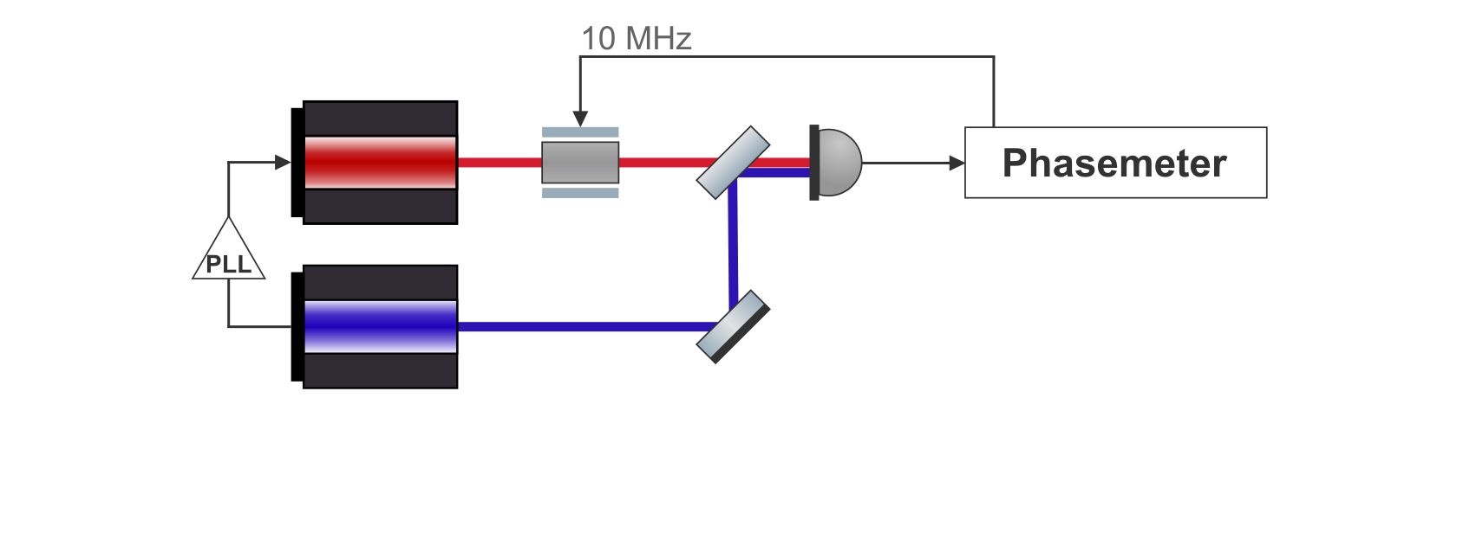
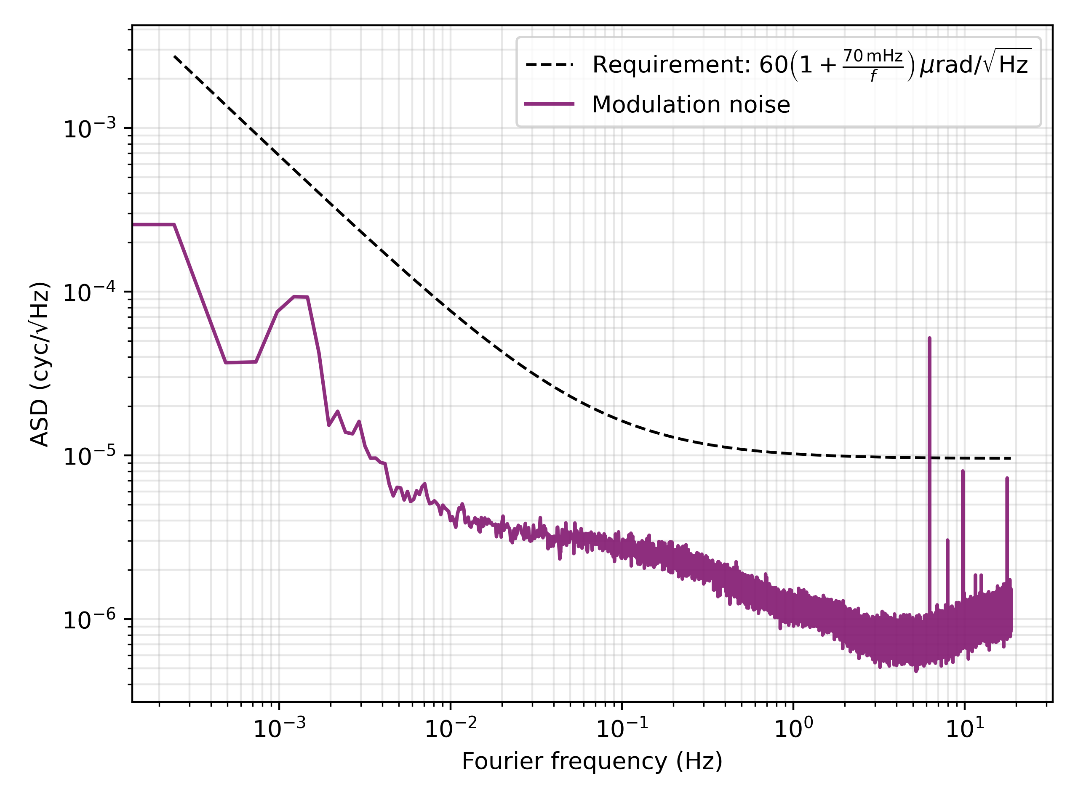
Modulation Noise Characterization
Notes:
Add fibers?

Slide 19
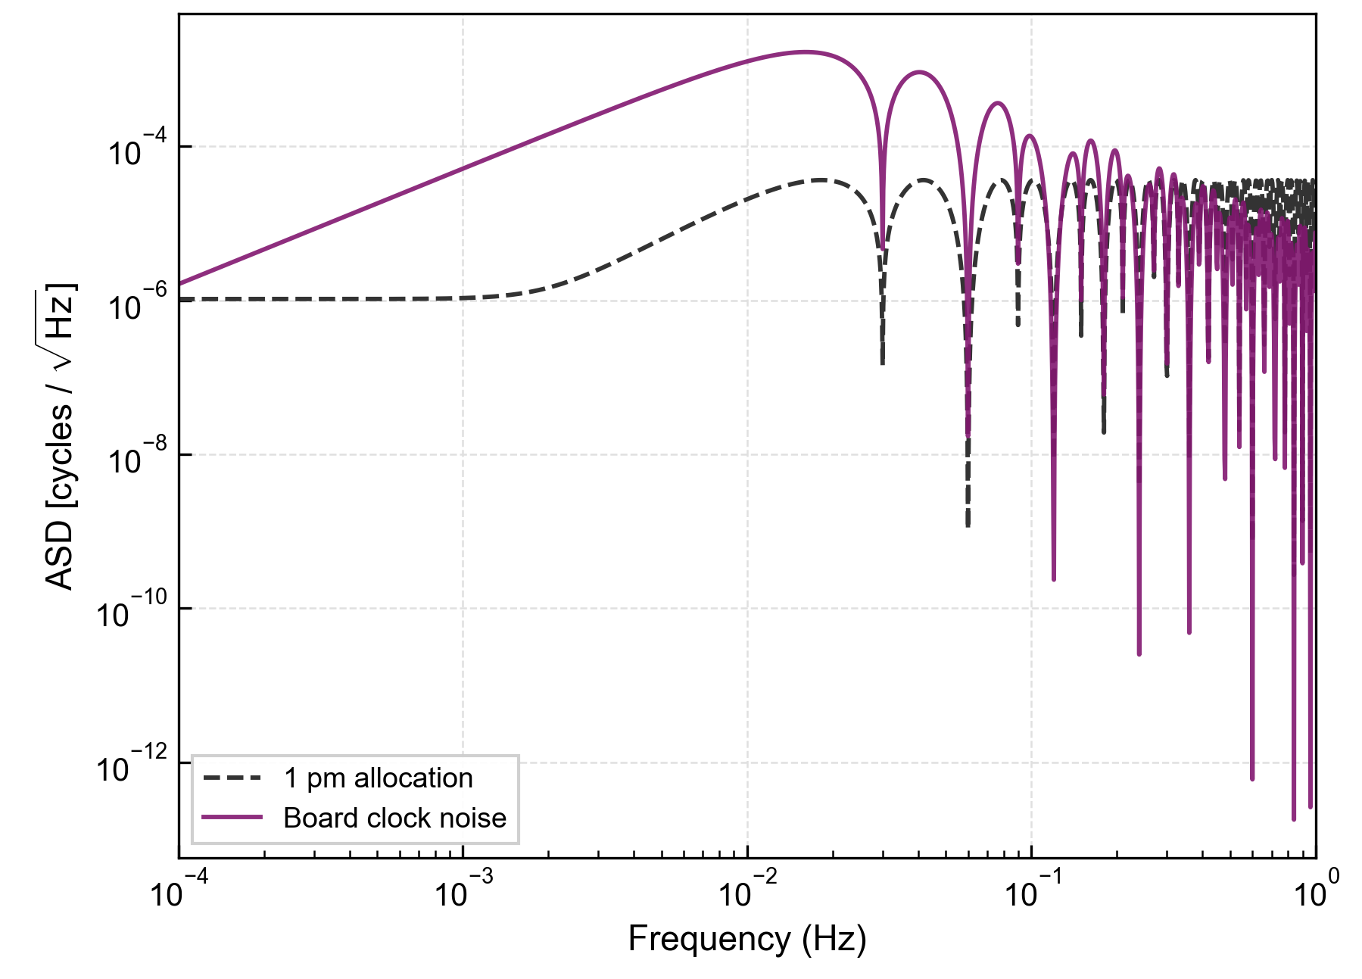
What to do with the clock noise?
Tests of Delay Line Board Clock Phase Noise
We are working on another layer of post processing remove this noise
Can be done after TDI and LISA-like clock noise removal
Only if the residuals are added
And rhen other noises should also be added
Notes:
Add something that indicates the residuals

Slide 20
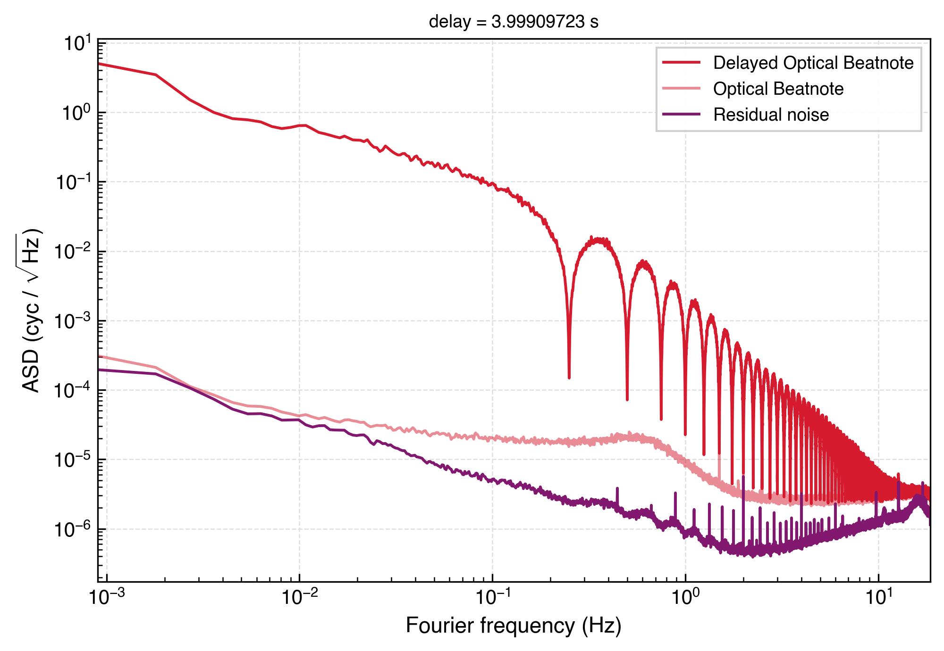
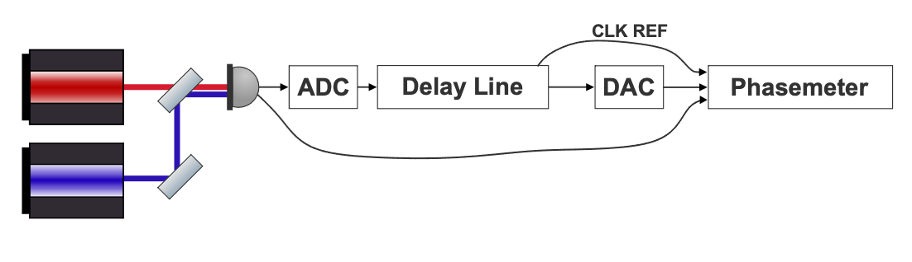
Experiments so Far
Tests of Delay Line Board Clock Phase Noise
A new baseline measurement with an optical signal and free running delay line board clock reveals a potential problem.
Notes:
Take out

Slide 21
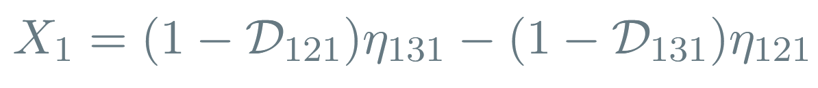
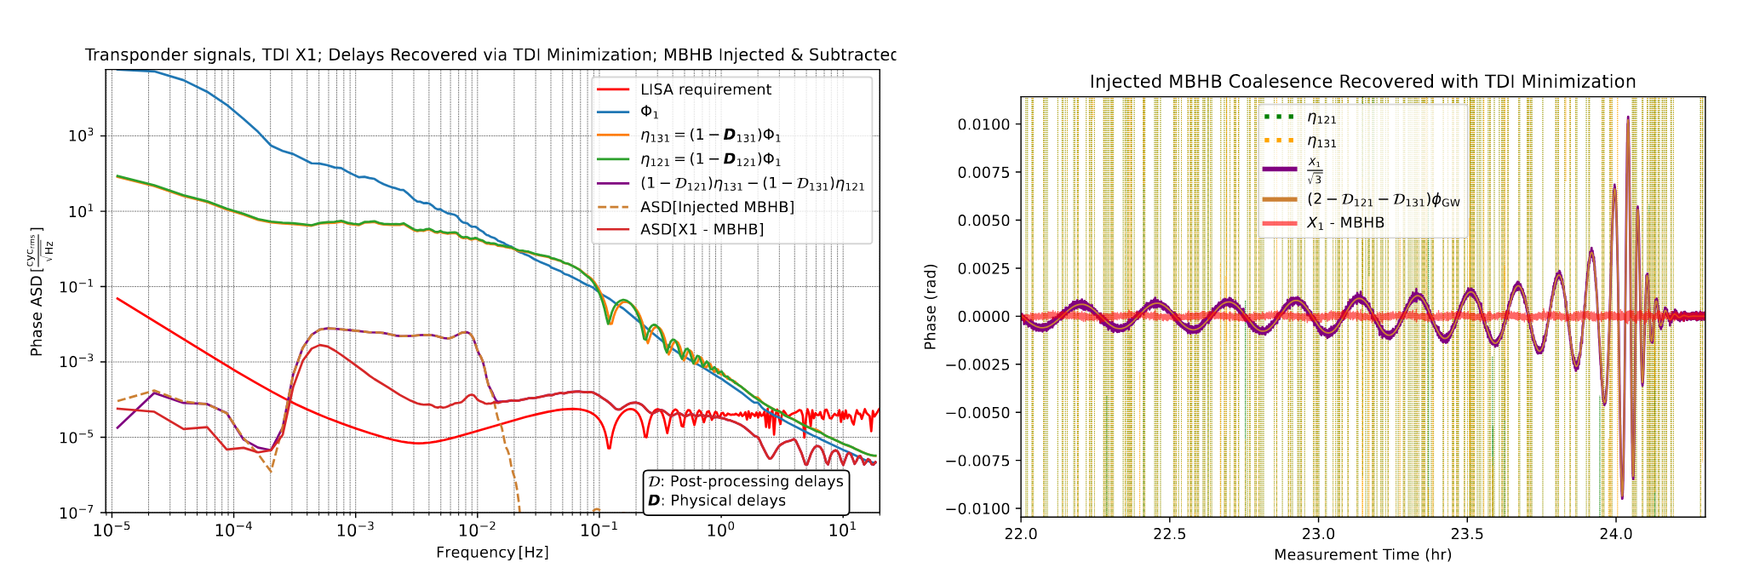
Experiments so Far
Fully electronic tests of TDI.
R. Ferguson et al., Applying TDI to Hardware-Simulated Data, 2025
Notes:
Update! If shown, show later

Slide 22
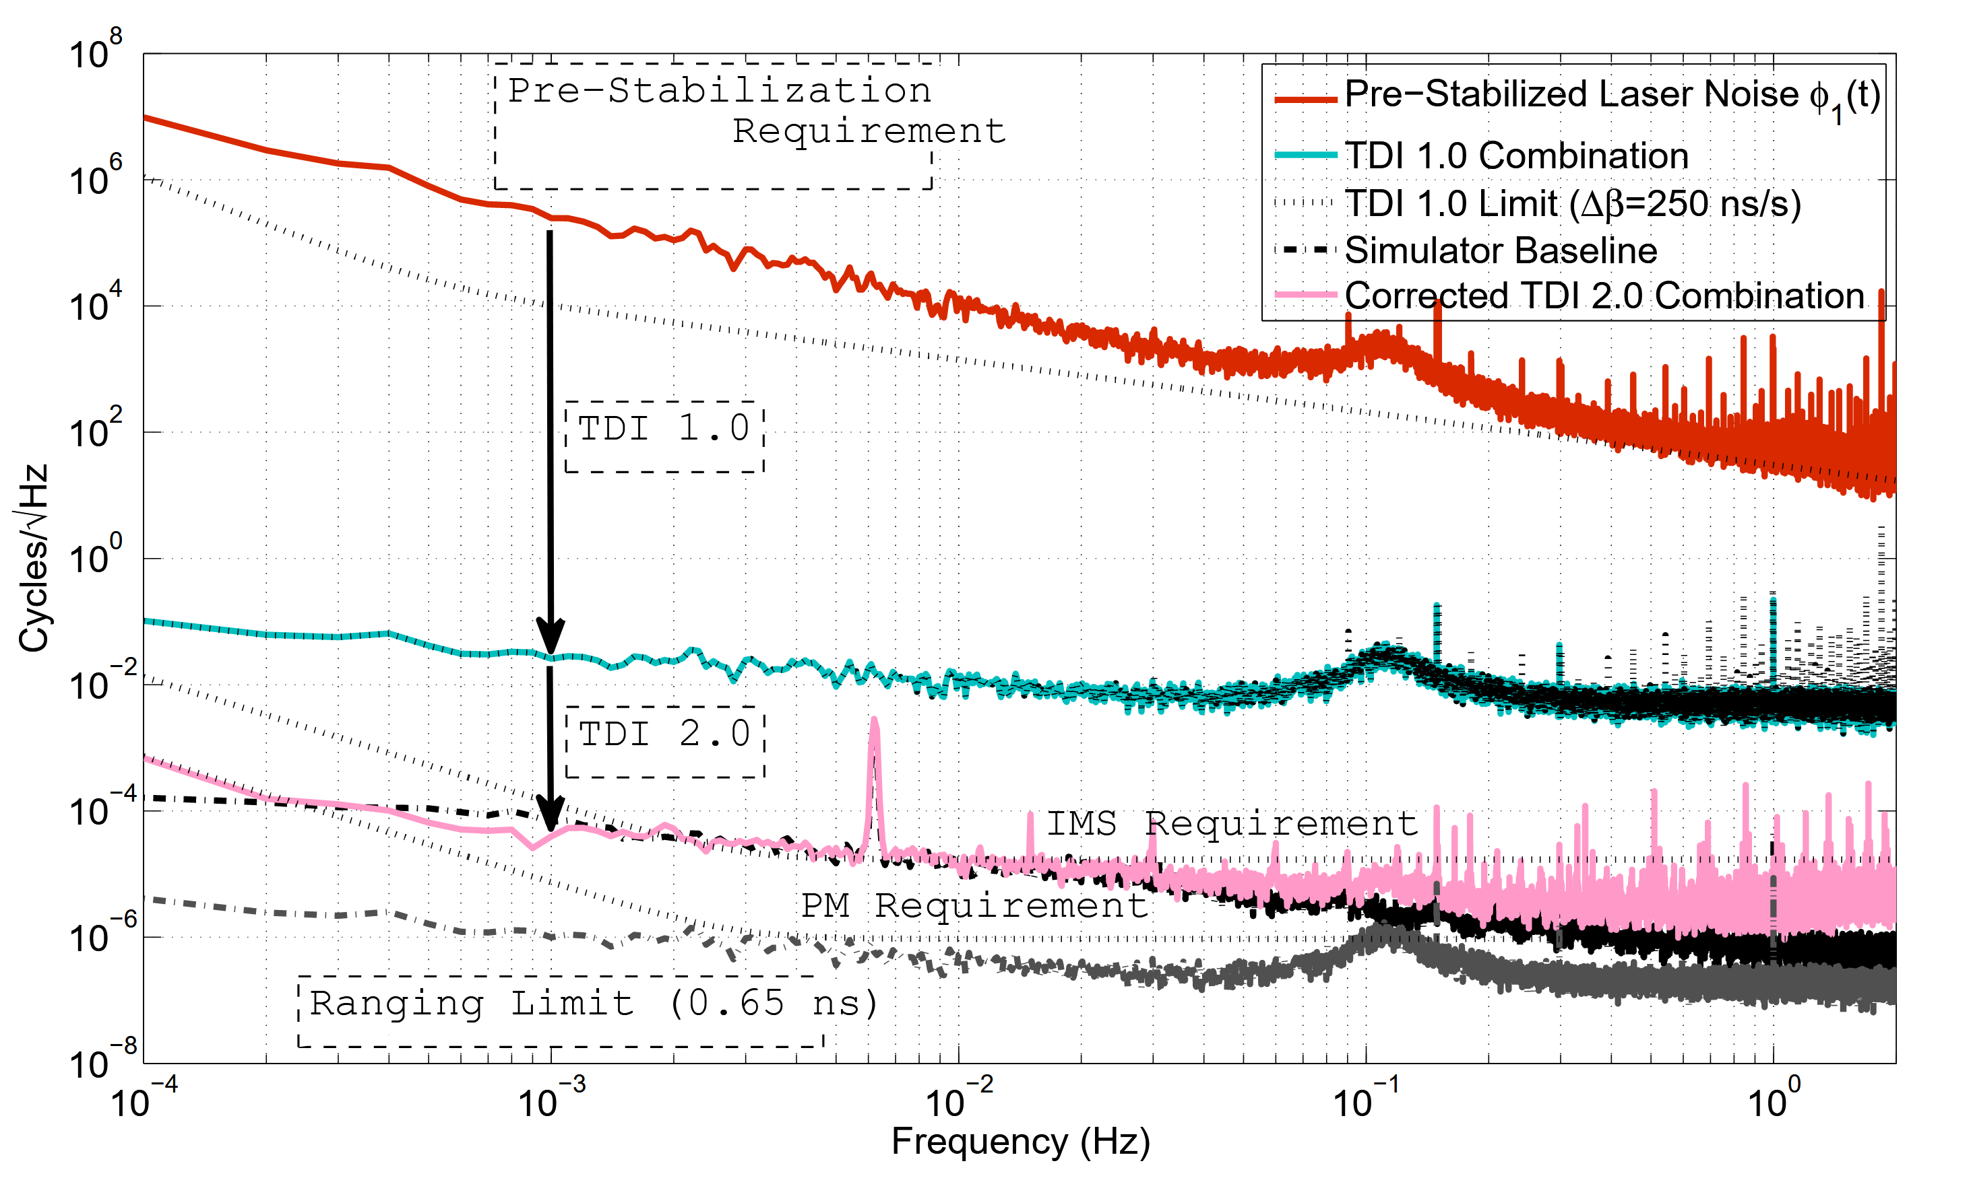
Predecessor Testbed
Results from University of Florida Laser Interferometry Simulator
TDI 1.0
Strain amplitude 4.35×10⁻²⁰
TDI 2.0
Credit: Mitryk, 2012
Notes:
Decades ago a testbed was build in University of Florida. Our design, which i will soon enough get to, was very similar to ours – so it is the predecessor to our testbed. The experiments performed were able to show that with TDI it is infact possible to cancel the laser noise orders of magnitude while preserving the gravitational wave signal. The strain used here is about two orders of magnitude higher that what was expected for LISA though. Overall the testbed was largely limited by the technology of the time – the baseline noise was high and the possibilities with adding GWs were limited. The testbed also didnt include the laserfield modulation for clock noise removal.

Slide 23
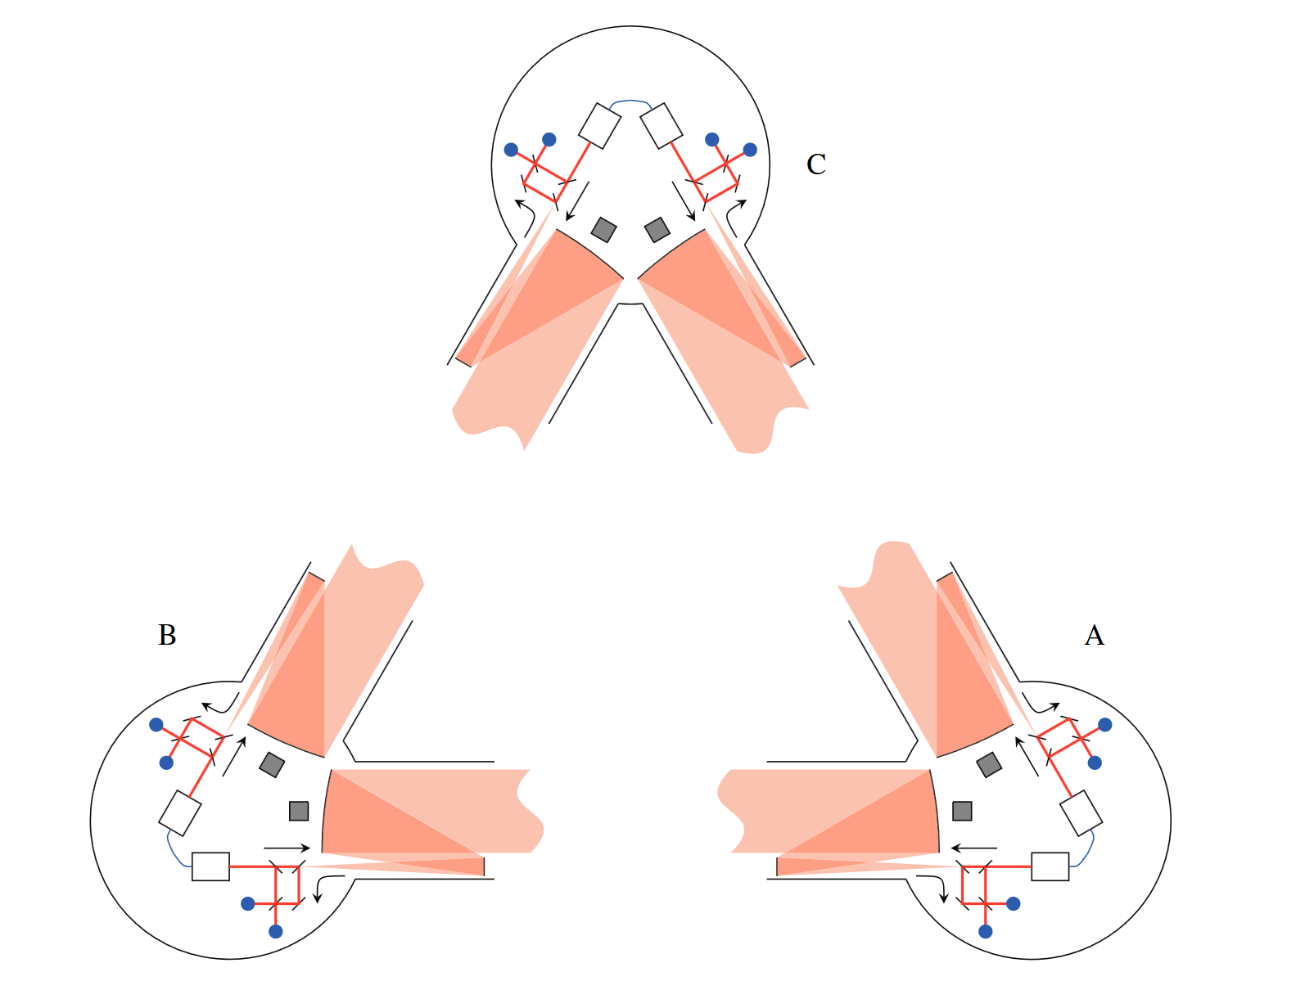
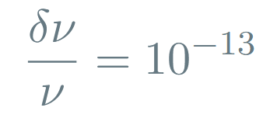
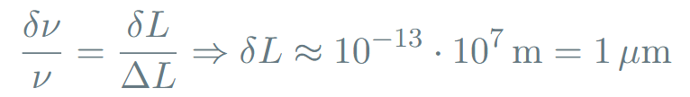

LISA Laser Frequency Noise
As per LISA requirements
Unequal arm lengths and laser frequency noise
Hence for the arm length uncertainty we get
But to be sensitive enough to detect GWs, we need
Credit: Jennrich, 2010

